Slide 1
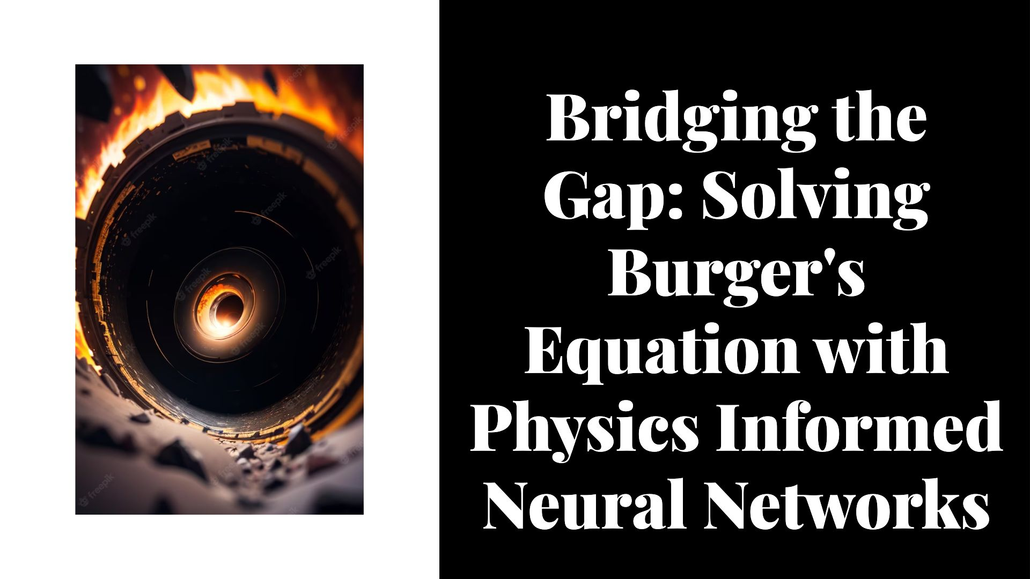

Slide 2


Slide 3


Slide 4
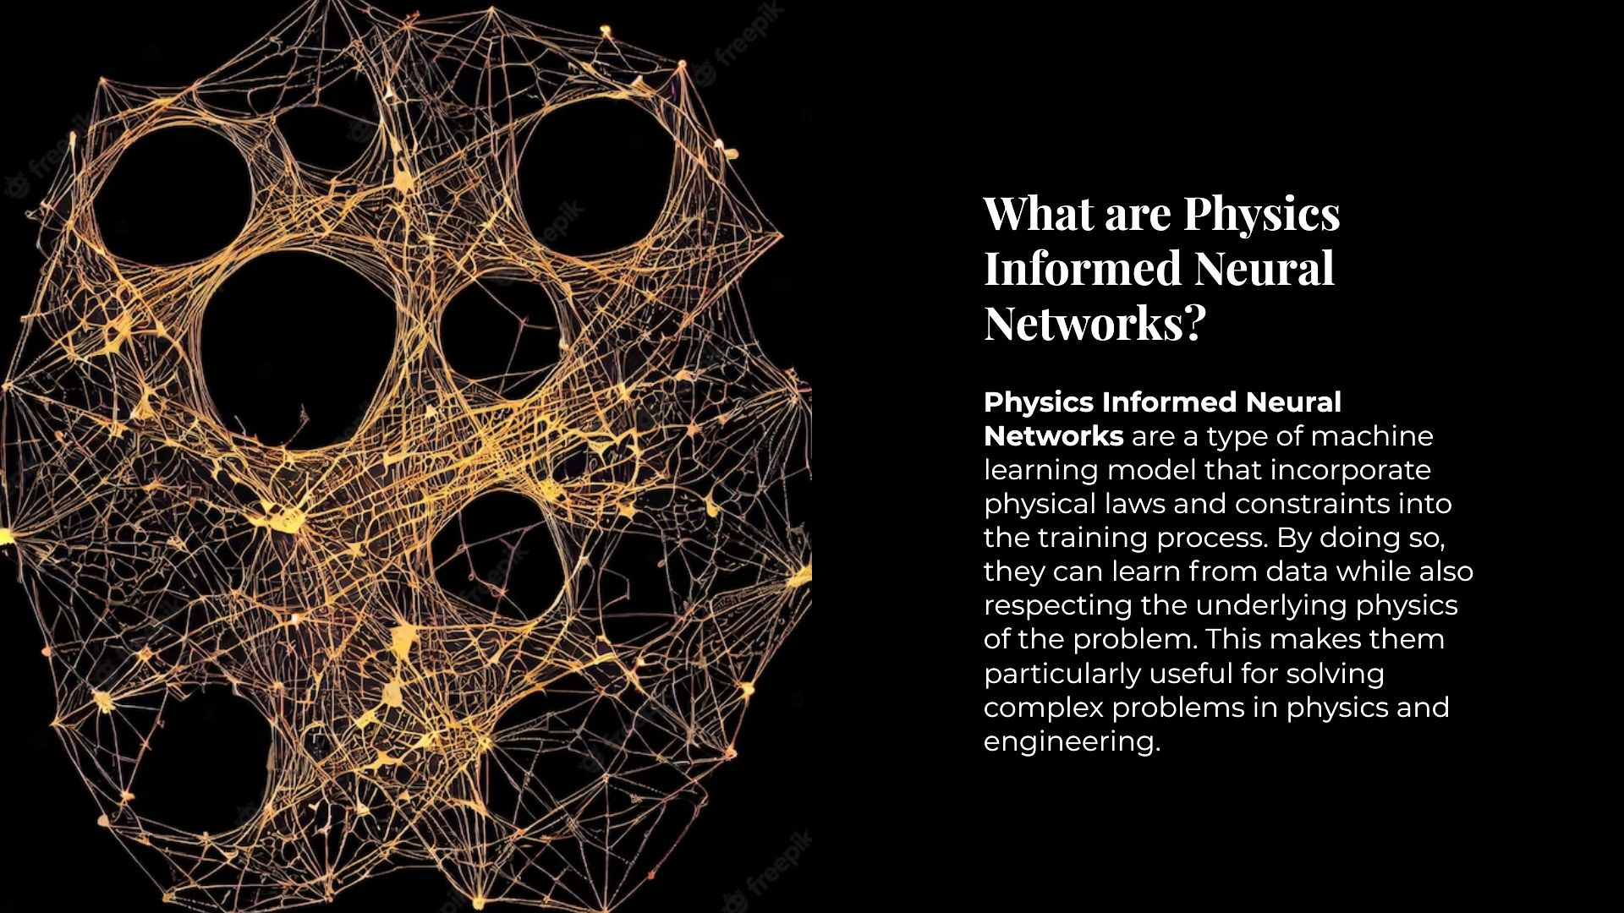

Slide 5
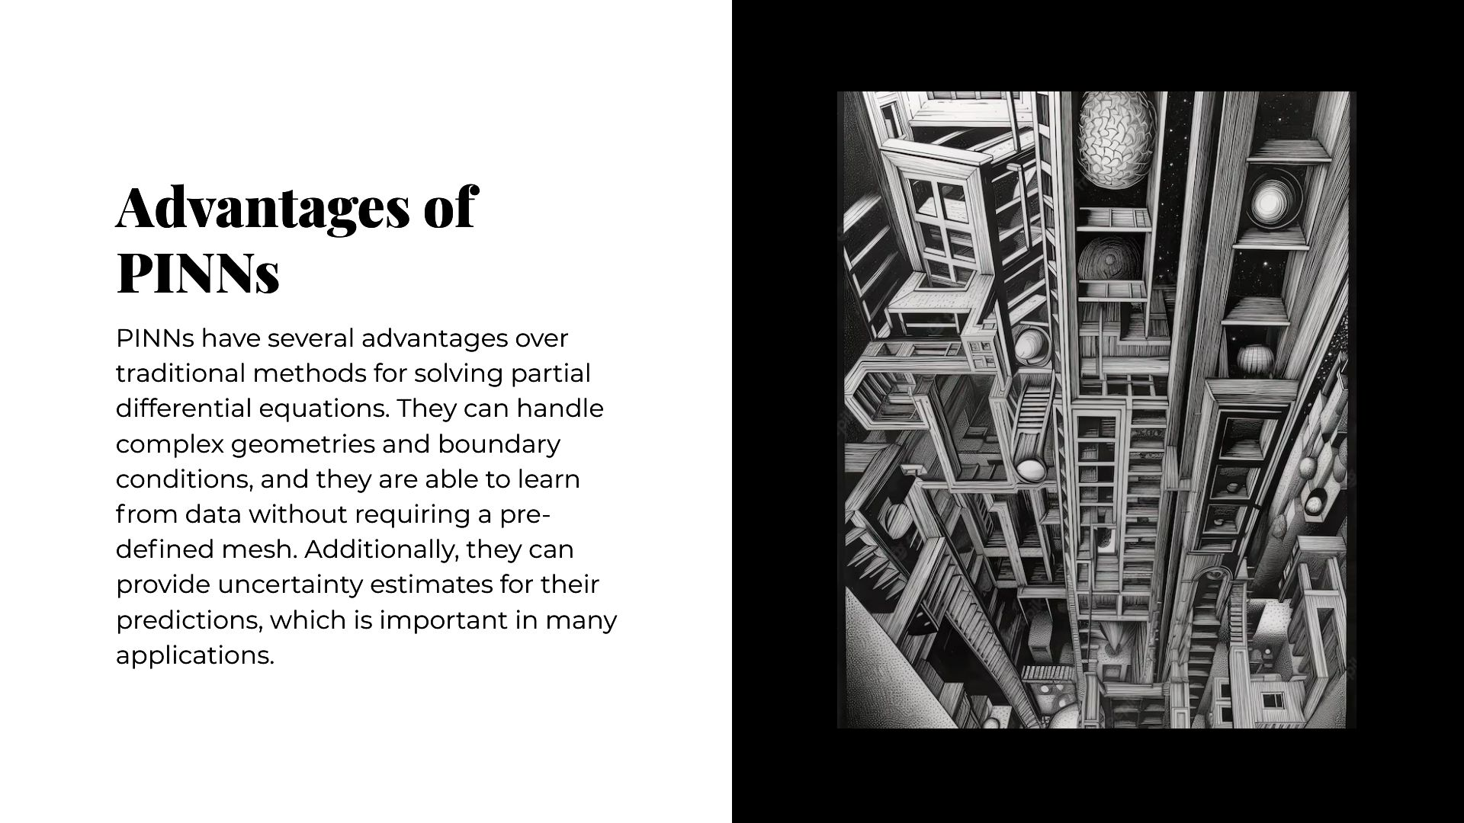

Slide 6
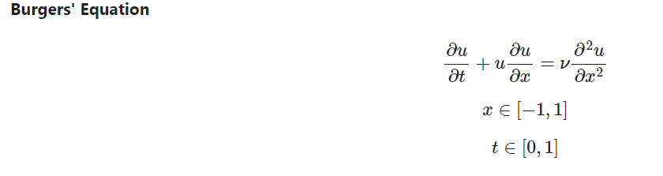
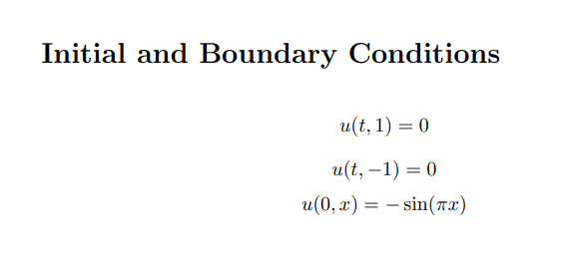

Slide 7
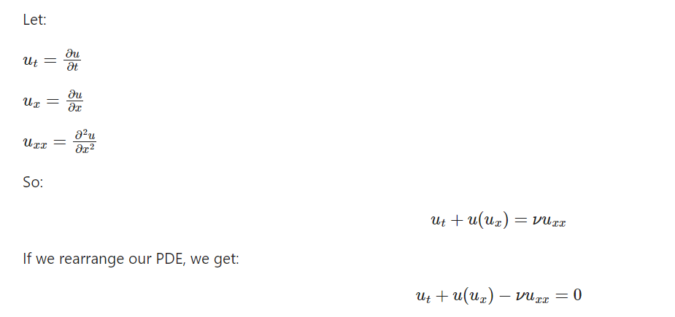

Slide 8
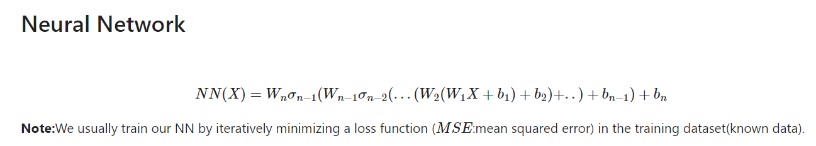
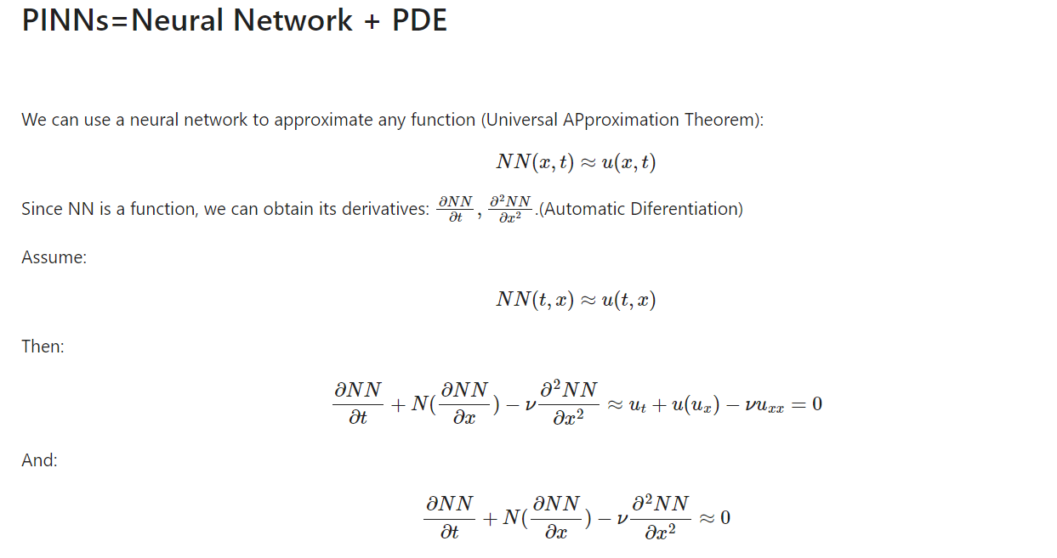

Slide 9
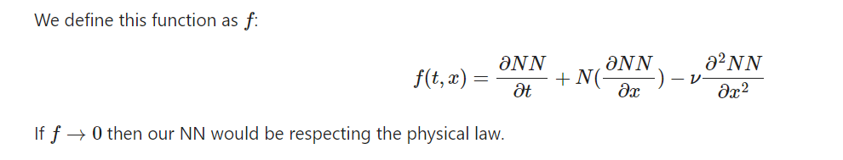
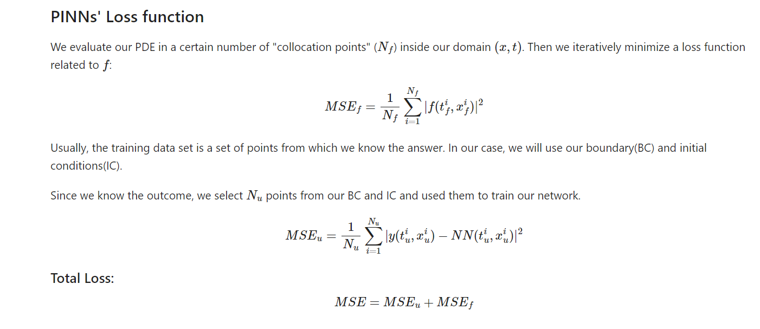

Slide 10
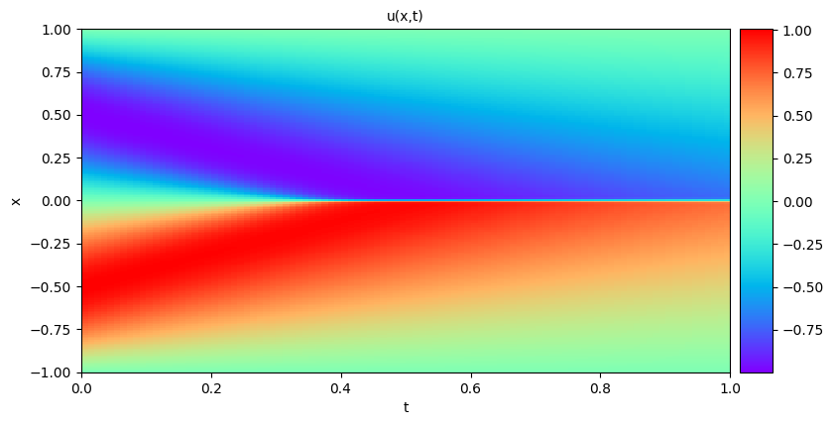
Plot of the solution
Link to the Google Colab Notebook : LINK

Slide 11
Procedure Used to implement PINNs for Solving Burger’s Equation
1. Data Preparation:
- Boundary training data (X_u_train) is collected as pairs of (x, t) coordinates.
- Boundary solution data (u_train) is collected.
- Collocation points (X_f_train) are collected as pairs of (x, t) coordinates.
2. PINN Initialization:
- The data arrays are transformed into torch tensors.
- The neural network (PINN) is defined as a class inheriting from torch.nn.Module.
- The PINN architecture consists of multiple fully connected layers with a hyperbolic tangent activation function.
3. PINN Forward Pass:
- The forward method in the NeuralNetwork class defines the forward pass of the PINN.
- The input (x, t) is passed through the fully connected layers with the activation function.
- The output represents the function u(x, t).
4. Physics-Informed Neural Network:
- The PhysicsInformedNN class is defined to handle the PINN operations.
- The class takes boundary and collocation data as inputs.
- The class initializes the necessary tensors, the PINN model, and the optimizer (LBFGS).
- The class defines methods to compute the predicted solution (u) and the residual (f) using automatic differentiation.

Slide 12
5. Training the PINN:
- The closure method is defined to compute the loss and update the gradients during each optimization step.
- The train method is called to start the training loop.
- The closure method is repeatedly called by the optimizer to update the PINN's weights and biases.
- The loss consists of two components: the boundary condition loss (u_loss) and the PDE loss (f_loss).
- The sum of these losses is minimized using the LBFGS optimizer.
6. Data Visualization:
- The plot method is defined to visualize the solution on new data.
- It generates a meshgrid of (x, t) points and evaluates the PINN's output.
- The solution is reshaped and plotted using matplotlib.
7. Data Generation:
- The generate_data function is defined to generate training points for boundary conditions and collocation points.
- It samples points for boundary conditions (X_u_train) and collocation points (X_f_train).
- The corresponding solution values (u_train) for the boundary conditions are also generated.
8. Training the Model:
- The generate_data function is called to obtain the training data.
- An instance of the PhysicsInformedNN class is created with the training data.
- The train method is called to train the PINN and find the optimal weights.

